Slide 1
<Insert title of presentation here>
DoubleTap
Tech5
Myriad

Slide 2
I. Company Overview

Slide 3
Background and Short History
Business Process Association of the Philippines (BPAP)
non-profit organization
founded in 2004
currently serves as a one-stop information and advocacy gateway for the industry

Slide 4
Vision-Mission Statement
Vision
To make the Philippines the number one destination for voice and non-voice services worldwide
Mission
Promote the competitive advantages and the growth potential of the Philippines in existing and new areas of outsourcing and support the industry in areas such as offshore marketing, education and training, security and privacy, legislation and public policy, among others

Slide 5
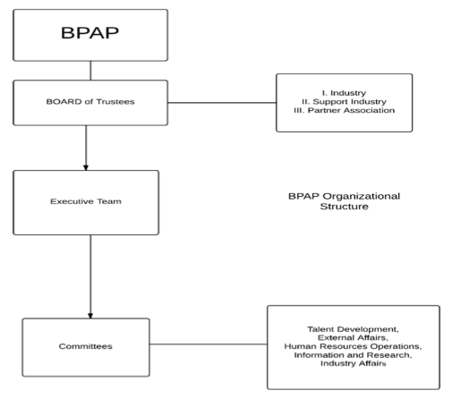
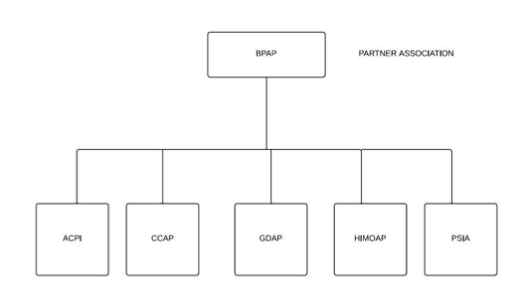
Organizational Structure

Slide 6
Products/Services of the Organization
assists the industry’s investor
provide support service to partner companies

Slide 7
Customers of the Organization
foreign investors
outsource their business processes here in the country
BPO companies
partner with Philippine government

Slide 8
BPAP-CHED-SEI Project
Overview
BPAP and SEI has partnered with CHED
P132M education and training program
Select SUCs to produce higher quality graduates
if successful, will open the possibility to create similar programs for other courses and industries
CHED project
1st year of implementation in 17 SUCs
teachers and students enrolled:
talent development programs: T3, SMP, eAdept, Best, and GCAT
industry professionals → teachers → students

Slide 9
BPAP-CHED-SEI Project
Project Partners
CHED
DOST-SEI
Values that Customer Wants from BPAP
bring value and excellence
develop the skill sets of IT & BA students
medium to teaching and training students and teachers
help 20,000 students and more than 500 teachers
By 2016, more Filipinos will have been employed

Slide 10
II. Current Situation

Slide 11
Project Title
BPAP Project Title:
Developing State University and College Graduates Towards Global Competitiveness, National Productivity and Development Project

Slide 12
Impact
increase in the employment percentage from the participating SUCs in the IT-BPM sector (ideally 70%)
program will be fully implemented in 17 SUCs
Programs/products:
Global Competitiveness Assessment Tool (GCAT)
Basic English Skills Training (BEST)
Electronic Advanced English Proficiency Training (e-ADEPT)
Service Management Program (SMP)

Slide 13
Current Programs Offered
GCAT
BEST
e-AdEpt
SMP

Slide 14
Problem Overview
Student Rollout
estimated tracking of 20,000 students per year
student must have participated in AT LEAST one of these programs
Different program qualifications and different requirements to be tracked
T3
Main part: train the teachers
keep track:
relationships of the trainings given to the teacher and the teacher to the students

Slide 15
Possible Projects
CRISP
Alternative 1: Separate system for each program
Alternative 2: Multiple-Database Reporting System using a Reporting Server
Alternative 3: EXCEL-Based Operations

Slide 16
Central Reporting and Information Systems for Participants and/or Programs (CRISP)

Slide 17
Central Reporting and Information Systems for Participants and/or Programs (CRISP)
capturing the data
monitoring the data
providing reports
3 subsystems:
Registry Reporting System (RRS)
Online Integrated Monitoring System (OIMS)
Computer-Aided Reporting System (CARS)

Slide 18
Registry Reporting System (RRS)
Data capture
3 activities:
importing data sent by Edulynx and AAI
enabling web distribution of PINs for e-Adept and BEST and collection of data stemming
importing data from the SUCs to the BPAP representative

Slide 19
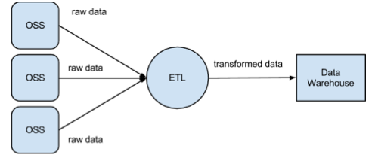
Online Integrated Management System (OIMS)
Data monitoring provided by RRS
2 functions:
extracting, transforming, and loading the data
monitoring the data through an interface

Slide 20
Computer-Aided Report Generation System (CARS)
Report generation
tool to help BPAP assess progress

Slide 21
Separate Systems for each program
Alternative 1:

Slide 22
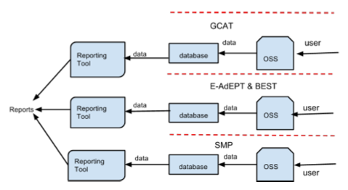
Separate Systems for each program
construct separate systems for eAdept, Best, SMP
own data-gathering, data monitoring, and reporting
reporting tools (e.g. SQL Reporting Services, Crystal Reports)
Own database for each system
Eliminate single repository of data

Slide 23
Multiple-Database Reporting System using a Reporting Server
Alternative 2:

Slide 24
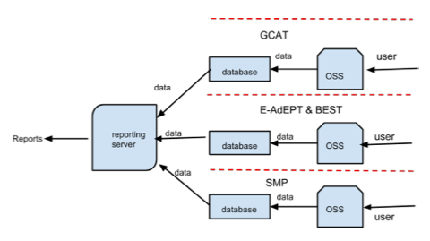
Multiple-Database Reporting System using a Reporting Server
web server configures data sources from each database of the separate systems
server will copy all the data using various database replication tools.
combine data from sources to be generated into reports
usually cleans and processes data more efficiently
logical design is almost the same as the first alternative

Slide 25
EXCEL-Based Operations
Alternative 3:

Slide 26
EXCEL-Based Operations
used as a database for keeping track information and business processes
Available reporting and data analysis tools
Excel files would not be able to handle the amount of data of BPAP records

Slide 27
III. Project Scope

